Slide 1
Sexual Harassment vs. Flirting
Review of definitions and examples

Slide 2
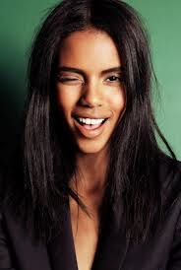
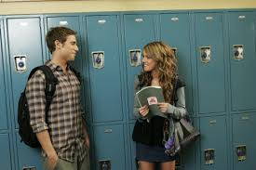
A few thoughts…
What are examples of common flirting that you that you have seen or experiences at school?
What is flirting?
What is sexual harassment?
Notes:
*Allow students to jot down thoughts on the white board. Help them separate the two.

Slide 3
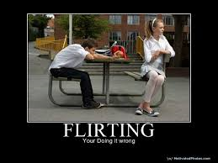
SEXUAL HARASSMENT
Sexual harassment is ANY sexual behavior that is unwelcome and makes the person feel uncomfortable or unsafe.

Slide 4


Flirting
Sexual Harassment
Flirting is welcome attention.
Flirting goes both ways.
Flirting makes you feel in control.
Flirting makes you feel good about yourself.
Flirting is legal in school.
Sexual harassment is not wanted.
Sexual harassment is one-sided.
Sexual harassment makes you feel put down or ugly.
Sexual harassment makes you feel powerless.
Sexual harassment is a violation of school rules.

Slide 5

Who decides if it is flirting or sexual harassment?

Slide 6


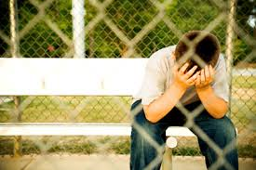
The VICTIM!

Slide 7
Sexual harassment happens in different ways:
Boys to Girls
Girls to Boys
Boys to Boys
Girls to Girls
What are some examples of each?
Notes:
*If time, have small groups come up with one example of each.

Slide 8

If sexual harassment is illegal in schools, why does it happen?
What do young people do that allows it to continue?
Notes:
*Give student the time to talk about this!

Slide 9
Least Harmful Most Harmful
←-----------------------------------------------------------------→
Wink Sexual Assault
Notes:
*Ask students what else could fall in this scale and where. Is ANYTHING on here ok or acceptable?

Slide 10
What if it happens to me or a friend?
Notes:
*Have students come up with options.

Slide 11

TELL SOMEONE! (Most importantly, tell a trusted adult.)
Be firm when you say NO or “I don’t like that. STOP.”
Avoid being alone with the harasser
Write down what happened

Slide 12
Sexual Harassment – True or False?
_____ If your intentions are good, your behavior isn’t sexual harassment.
_____ Sexual harassment is a minor annoyance. It never really hurts
anyone.
_____ Kids who are sexually harassed usually do something to invite it.
_____ Sexual harassment does not occur when kids like each other.
_____ If everyone else thinks that a behavior is okay, you should just
accept it, even if it bothers you.
_____ Sexual harassment is all about boys harassing girls.
_____ Sharing dirty pictures or jokes can be sexual harassment.
_____ Spreading rumors about someone’s sexual activity is a form of
sexual harassment.
_____ Sexual harassment is just an immature way of telling someone you like them.
_____ Someone may not realize they are sexually harassing another person.
F
F
F
F
F
F
T
T
F
T

Slide 13
Flirting or Harassment?
_____ “You are really looking good today.”
_____ “Those jeans look great – nice and tight.”
_____ “Did you hear the joke about the blond who got a boob job?”
_____ “That sweater makes your eyes looks so blue.”
_____ “With that body, you should be a model.”
_____ “I love your new haircut.”
_____ “Great muscles – do you work out?”
_____ “You look so sexy in that dress.”
_____ “I know you want a massage. You’re just playing hard to get.”
_____ “Those track shorts look cute on you.”
F
H
H
F
H
F
H
H
H
F

